Slide 1
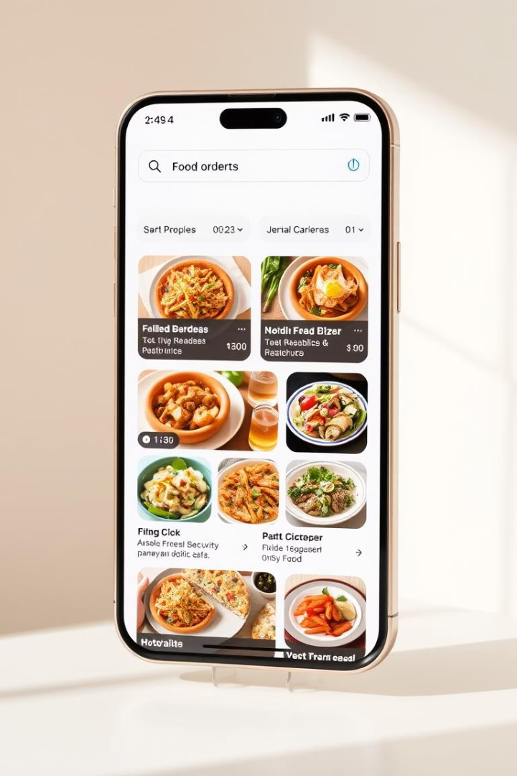
Food Ordering Application Project
Presented by Sushovan Chakraborty, AIML/22/041
Contact: chakrabortysushovan2@gmail.com

Slide 2
Project Overview & Architecture
About the Project
System Architecture
Full-stack web app for online food ordering
React frontend
Real-time order tracking
Spring Boot backend
MySQL database
Streamlined restaurant-customer process
JWT-based security

Slide 3

Key User Roles and Features
Customer
Admin
Browse, order, track, manage profile
Menu, orders, users, analytics, promotions
Employee
Update order status, delivery assignments

Slide 4

Frontend Technology: React JS
Modern UI
REST API
Responsive Design
Hooks for seamless navigation
Efficient communication, 99.9% uptime
Bootstrap for device compatibility

Slide 5

Backend Technology: Spring Boot (Java)
1
REST API
2
Scalability
Robust backend for complex requests
Supports 10,000+ concurrent users
3
Spring Data JPA
Simplifies database queries and management

Slide 6
Database and Security
MySQL Database
Security
Structured and optimized data storage
Spring Security framework
99.99% availability
JWT token-based authentication
Efficient data retrieval
Role-based access control

Slide 7
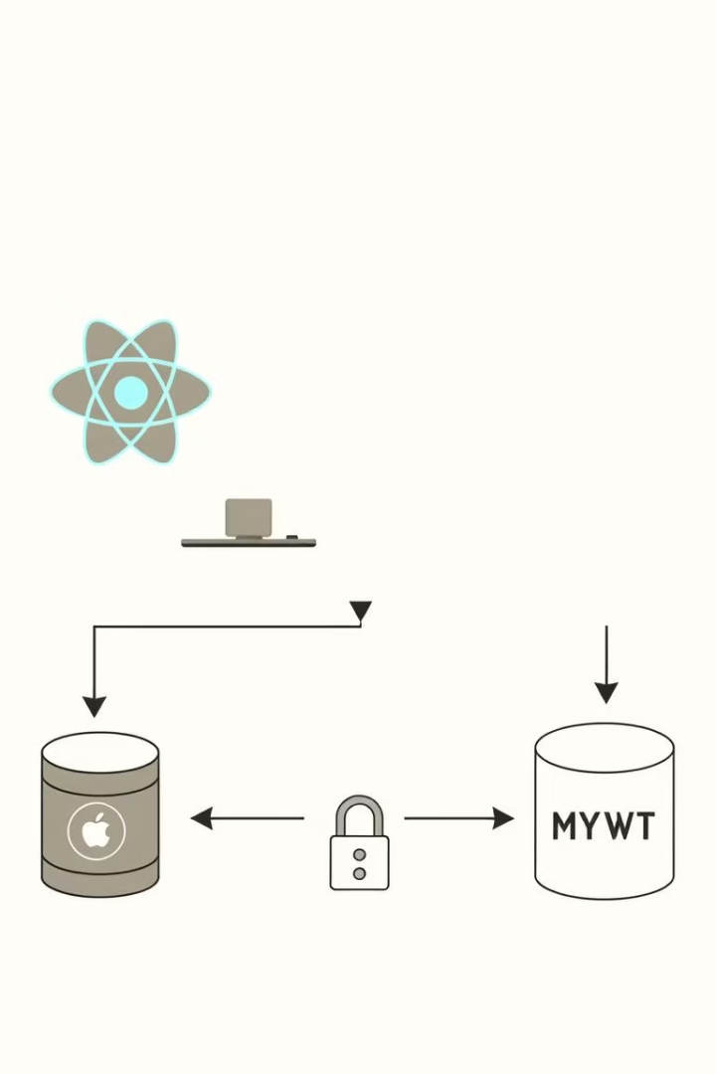




System Architecture Details
Client
React app sends REST requests
Server
Spring Boot manages logic
Database
MySQL stores secure data
Security
JWT tokens authenticate users

Slide 8

Future Enhancements
Mobile Apps
Reviews & Ratings
Native iOS and Android development
Payment Integration
Customer feedback features
Push Notifications
Supports multiple gateways
Real-time order updates

Slide 9
Thank You

